Slide 1
Lecture 15 CSE - 4101 Topic: Introduction to Robotics

Slide 2
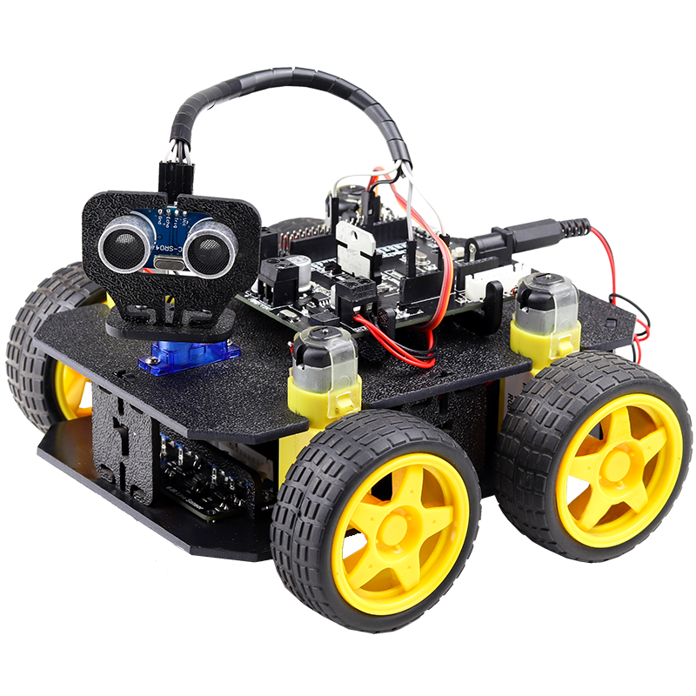
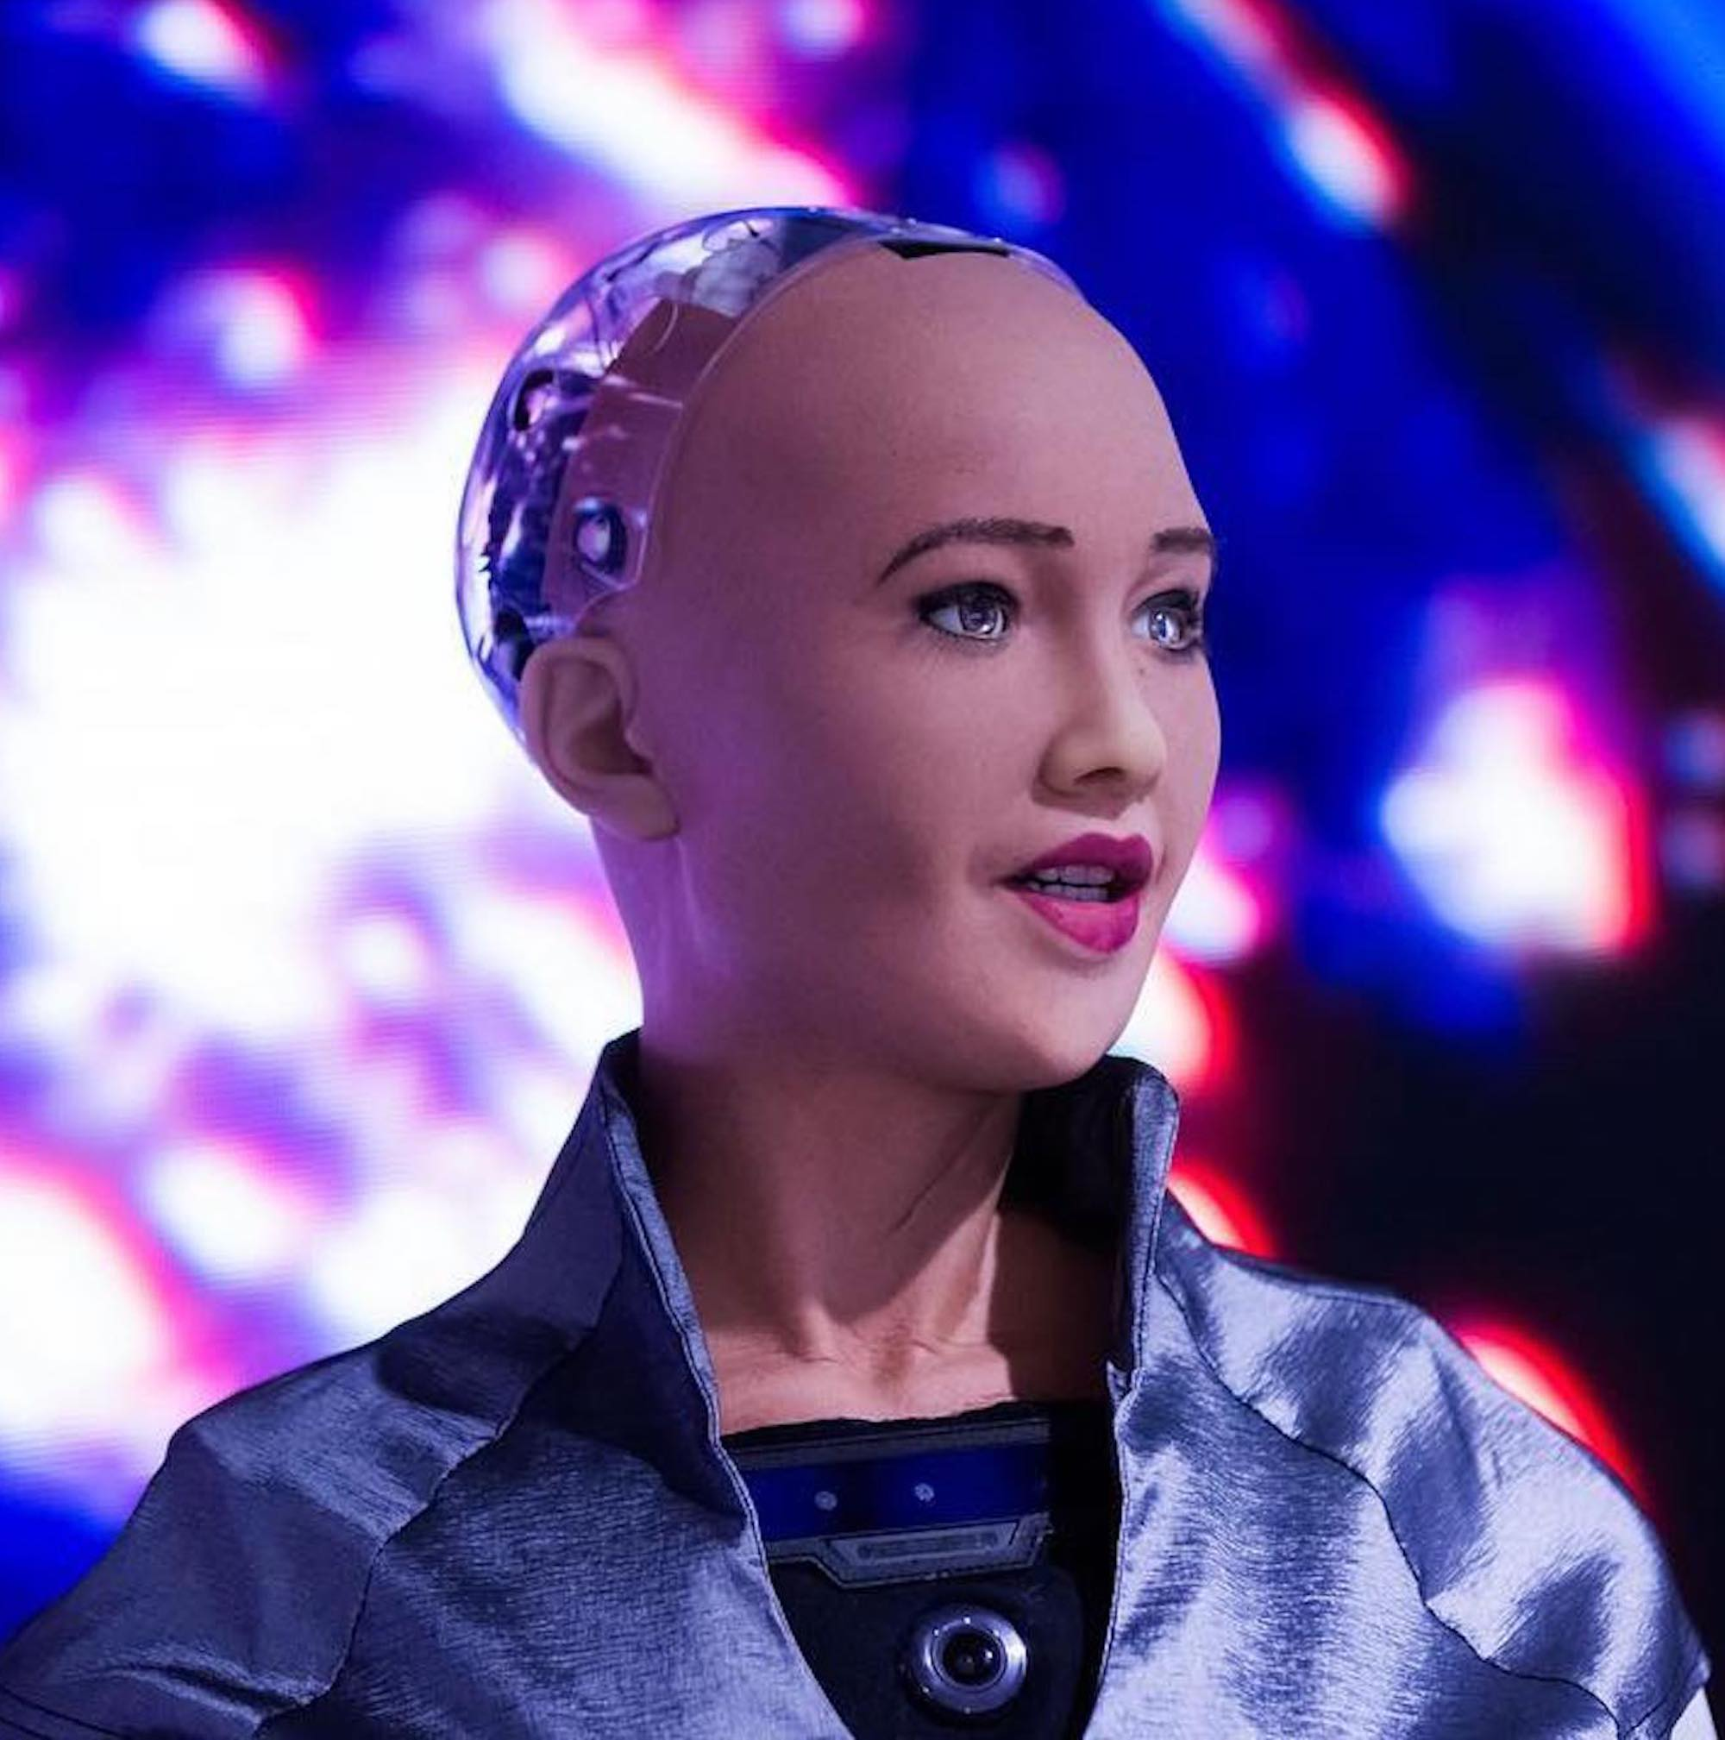
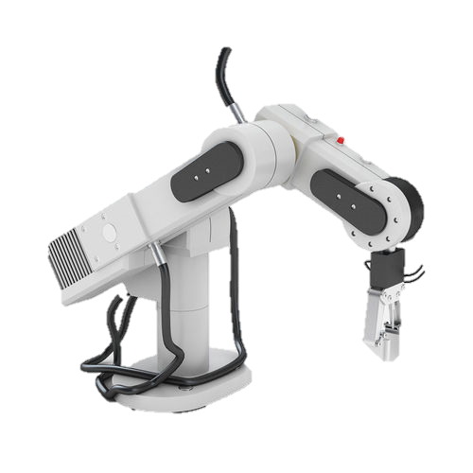
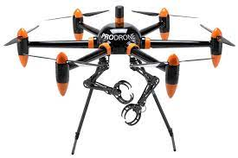
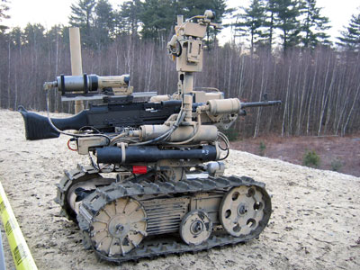
Introduction
World War 3 will be a war of AI, Nuclear, Bio-chemical weapons and Robots.

Slide 3
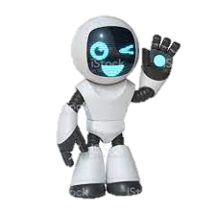
Introduction
1495 : Leonardo DaVinci designs a mechanical device that looks like an armored knight. The mechanisms inside “Leonardo’s robot” are designed to make the knight move as if there was a real person inside.
1920 : Czechoslovakian playwright Karel Capek introduces the word robot in the play “R.U.R- Rossum’s Universal Robots”. The word robot comes from Czech word “robota” which means forced labor.
1942: Issac Asimov publishes Runaround, in which he defines the Three Laws of Robotics.

Slide 4
Introduction
1951 : In France, Raymond Goertz designs the first teleoperated articulated arm for the ATOMIC ENERGY COMMISSION. This is generally regarded as the major milestone in force feedback
technology (Force feedback devices use motors to manipulate the movement of an item held by the user).
1954 : George Devol designs the first programmable robot and coins the
Term Universal Automation, planting the seed for the name of his future company Unimation.
Articulated = produced

Slide 5
Robot
The Robotic Industries Association (RIA) defines a robot as a reprogrammable, multifunctional manipulator designed to move material, parts, tools, or specialized devices through variable programmed motions for the performance of a variety of tasks(1980).
The branch of technology that deals with the design, construction, operation, and application of robots, as well as computer systems for their control, sensory feedback, and information processing is ROBOTICS.
ROBOTICS is a combination Computer Science, Mechanical Engineering, Electronics Engineering

Slide 6
Robot Types
There are different types of robots. But they can be divided in 2 broad
Categories.
A mobile robot is a machine controlled by software that uses sensors and other technology to identify its surroundings and move around its environment. It functions using a combination of artificial intelligence (AI) and physical robotic elements, such as wheels, tracks, and legs.
A manipulator robot is a reprogrammable and multifunctional mechanical device that moves materials, parts, objects, or tools through programmed motions to perform various tasks. It is composed of a series of jointed segments that form an arm-like manipulator. It is fixed and can not move around its environment.

Slide 7
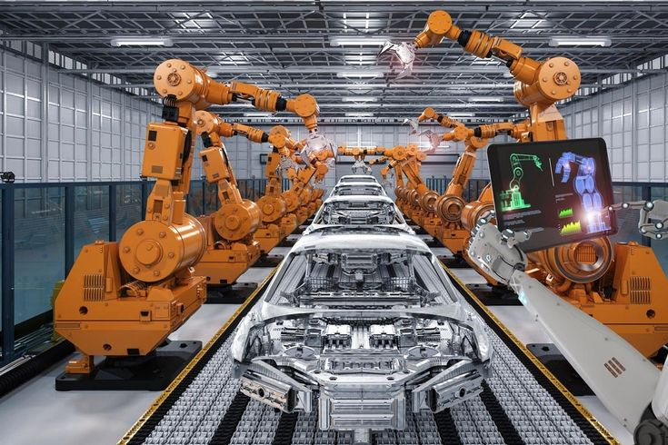
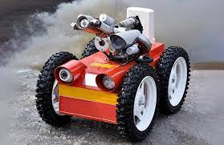
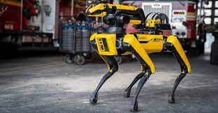
Robot Types
Mobile Robots
Manipulator Robots

Slide 8
Robot Characteristics
Essential characteristics:
Sensing: Robot would have to be able to sense its surroundings. Light sensors (eyes), touch and pressure sensors (hands), chemical sensors (nose), hearing and sonar sensors (ears), and taste sensors (tongue) gives awareness of environment.
Movement: Robot needs to move around its environment. Whether rolling on wheels, walking on legs or propelling by thrusters a robot needs to move.
Energy: A robot needs to power itself. A robot might be solar powered, electrically powered, battery powered.
Intelligence: A robot needs some kind of intelligence. A programmer gives the robot its intelligence via program so that it knows what it is to do. Artificial Intelligence plays big role.

Slide 9
Law of Robotics
Isaac Asimov's "Three Laws of Robotics"
A robot may not injure a human being or, through inaction, allow a human being to come to harm.
A robot must obey orders given by human beings except where such orders would conflict with the First Law.
A robot must protect its own existence as long as such protection does not conflict with the First or Second Law.

Slide 10
Robot Applications
Machine loading
Pick and place operations
Wielding
Painting
Assembly operation
Manufacturing
Surveillance
Medical arena: (helping the elderly and Disables, hospital delivery, surgical robots)
Hazardous environments
Exploration (planetary, undersea, polar)
Search and rescue (earthquake rescue; demining)
Mining and heavy transport, container handling
Military (unmanned aircraft and submarines, insect robots)
Domestic (Vacuum cleaning, lawn mowing, laundry, clearing the table, etc.)
Transport (Autonomous cars)
Entertainment (Sony AIBO, QRIO, Lego Mindstorms, Robocup competition)

Slide 11
Advantage and Disadvantage of Robots
Advantages
Can work in hazardous environments
Need no environmental comfort
Work continuously without experiencing fatigue
Have repeatable precision at all times
Can be much more accurate than human
Can process multiple tasks simultaneously
Disadvantages
Replaces human workers creating economic problems
lack capability to respond in emergencies
although superior in certain senses, have limited capabilities in Degree of freedom, Skill, Sensors, Vision system, Real time response system
Costly: due to Initial cost of equipment, Installation costs, need for peripherals, need for training, need for programming.

Slide 12
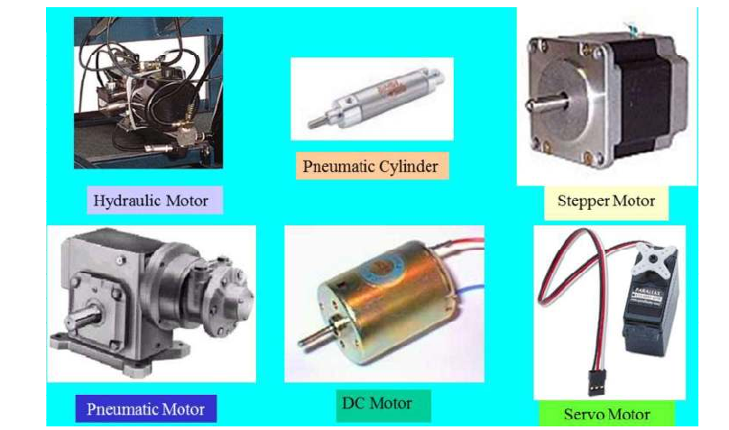
Components of Robot
A robot as a whole consists of the following elements which are integrated together to form a whole.
Manipulator
End effector
Actuators
Sensors
Controller
Beside this each robot needs a power supply provides energy to drive the controller and actuator. The three basic types of power supplies are electrical, hydraulic, and pneumatic (operated by air or gas under pressure).

Slide 13
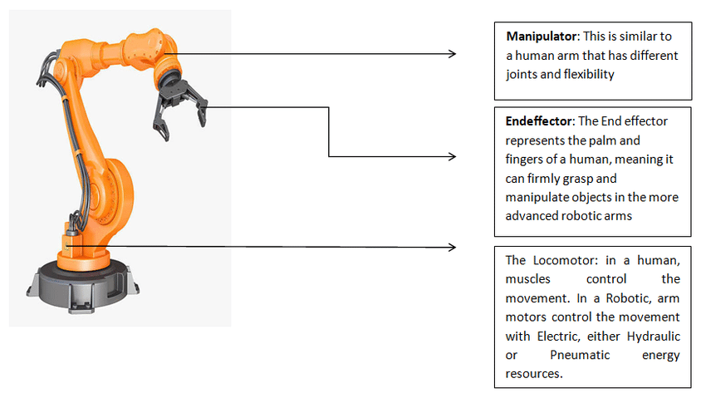
Manipulator/Robot Arm

Slide 14
Manipulators
The manipulator is the arm of the robot which move materials, parts, tools or special devices through various motions to provide useful works.
There are mainly two types of joints that are found in robot manipulators: sliding joints and rotational joints. (There are some others such as (ball joint, screw joint).
The first is a prismatic joint/sliding joint where the pair of links makes a translational displacement along a fixed axis. In other words, one link slides on the other along a straight line. Therefore, it is also called a sliding joint.

Slide 15
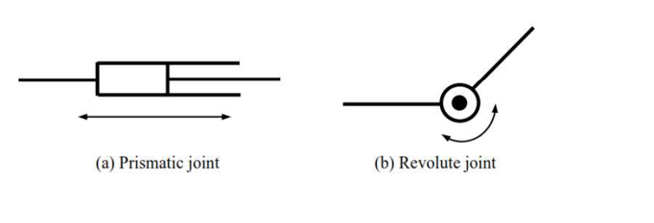
Manipulators
The second type of primitive joint is a revolute joint where a pair of links rotates about a fixed axis. This type of joint is often referred to as a hinge, articulated, or rotational joint.
Tachometer is a device used to measure speed of an object. In the case of robotic systems, a tachometer is used to measure acceleration and deceleration of the manipulators movements

Slide 16
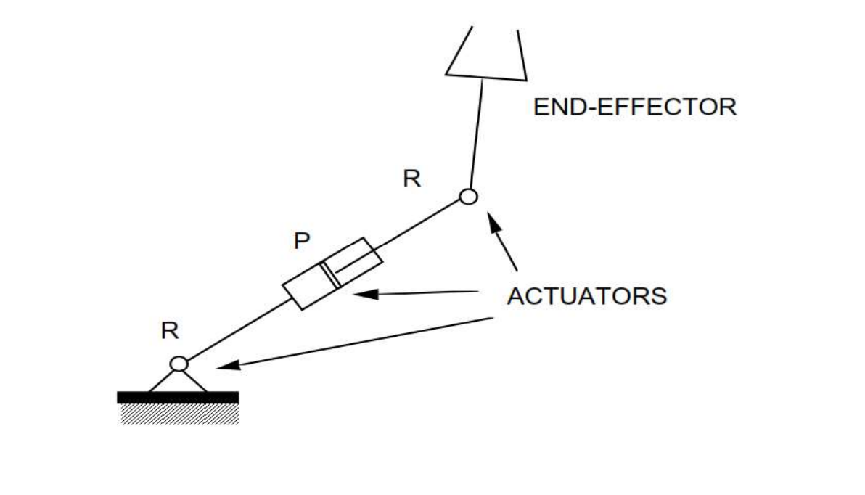
Manipulators
Figure: Schematic of a planar manipulator with two revolute and one
prismatic joints

Slide 17
Actuator
A robot uses actuators to move its arm along programmed paths and then to hold its joints rigid once the correct position is reached.
Actuators are muscles of the manipulators.
An actuator is a motor that converts power into robot movements.
The working principle of a robot actuator is to change the energy into physical motion and most actuators generate linear or rotary motion.

Slide 18
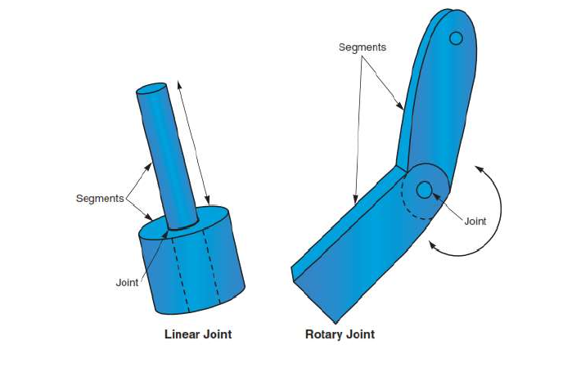
Actuator
There are two basic types of motions provided by actuators: linear and rotary.
Linear actuators provide motion along straight line. One the other hnad Rotary actuators provide rotation, moving their loads in an arc or circle.
Figure 2.6 Actuator Joints

Slide 19
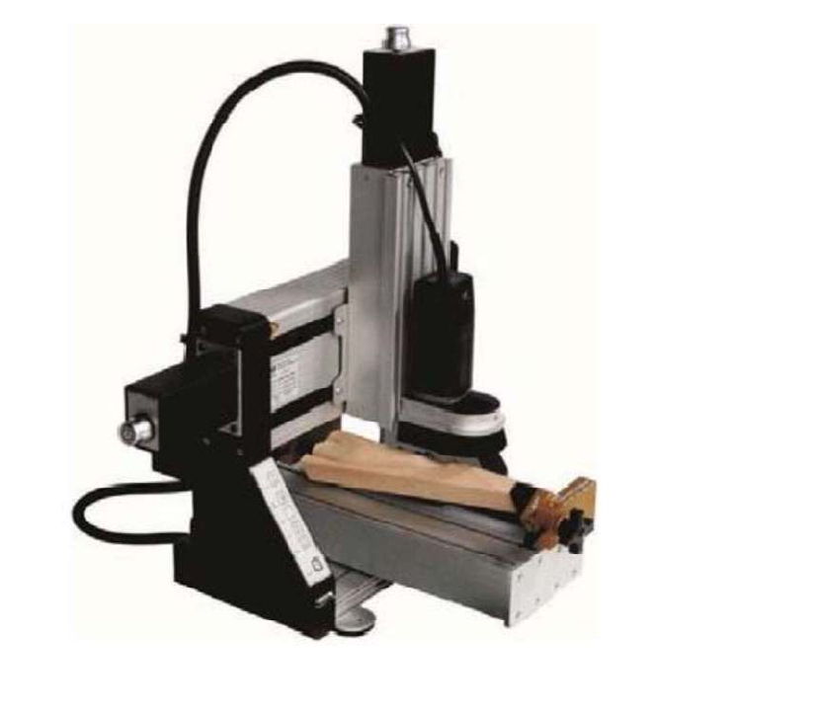
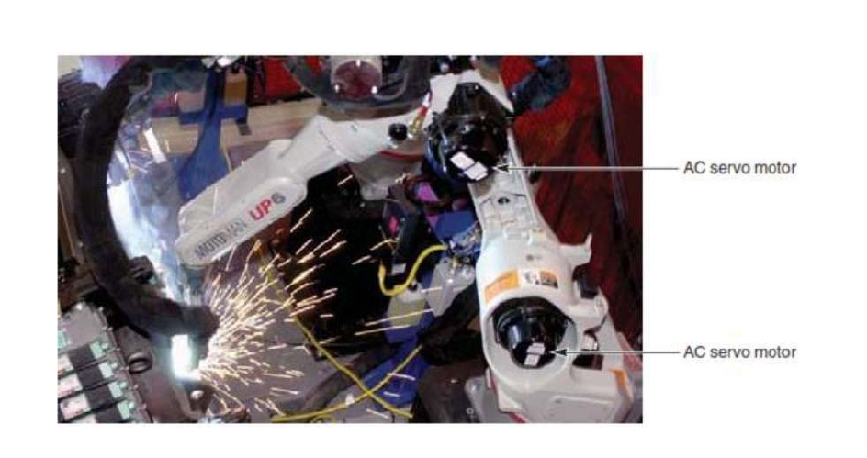
Actuator
Figure 2.10 Heavy-Duty Industrial Robot Using AC Servo Motors
Figure 2.11: DC Stepper Motors Used to Control Educational Robots

Slide 20
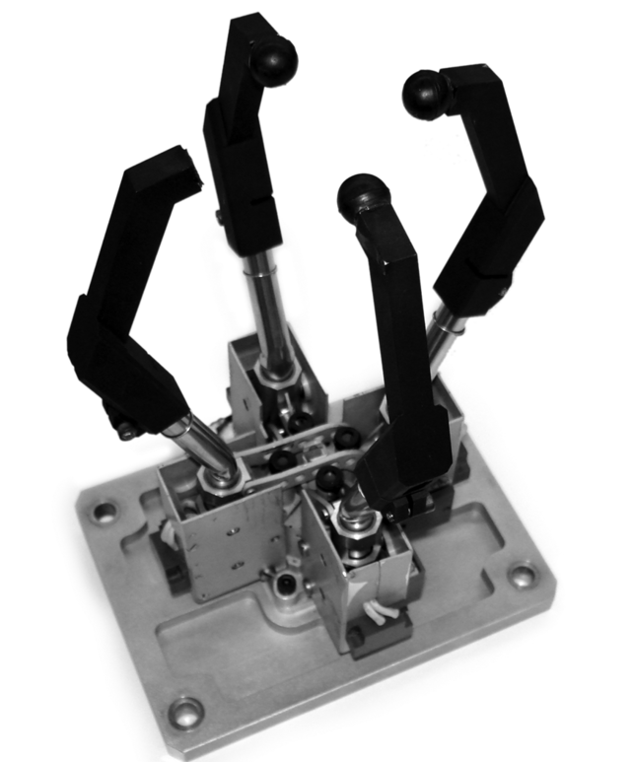
End-Effectors
An end effector is a peripheral device that attaches to a robot’s wrist, allowing the robot to interact with its task.
It end effector represents the palm and fingers of a human, meaning it can firmly grasp and manipulate objects using the more advanced robotic arms.

Slide 21
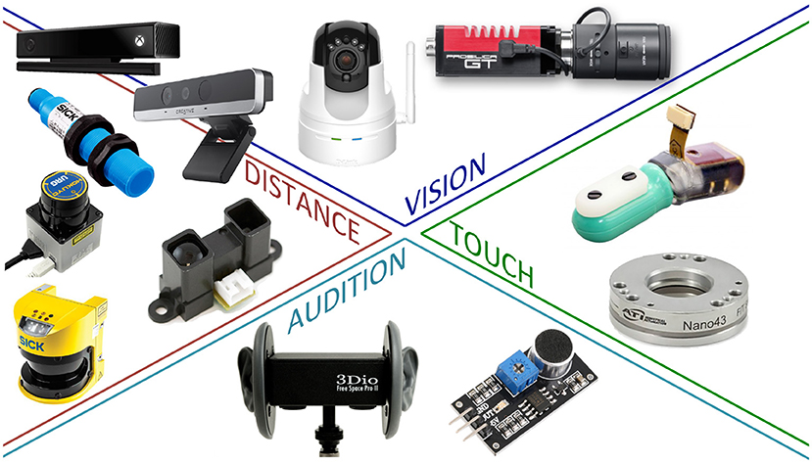
Sensors
Sensors is used to measure the condition of the robot and its surrounding environment.
Sensors pass electronic signals to robots for executing desired tasks.

Slide 22
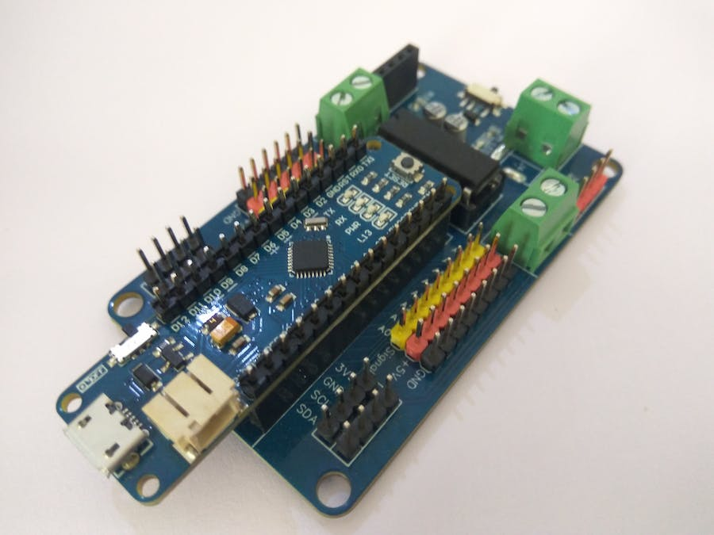
Controllers
The controller executes the programming to operate the robot.
A controller is also the mechanism that interfaces with other devices such as sensors, external motion axes, vision systems, IT/manufacturing information systems and even other robots.

Slide 23
Controllers
The controller coordinates all movements of the mechanical system. It receives input from the environment through the various sensors.
The heart of robot’s controller is generally a microprocessor linked to input/output and monitoring devices A microprocessor can be embedded with a controller and it has its own user interface. It is also used to measure the velocity of the robot.

Slide 24
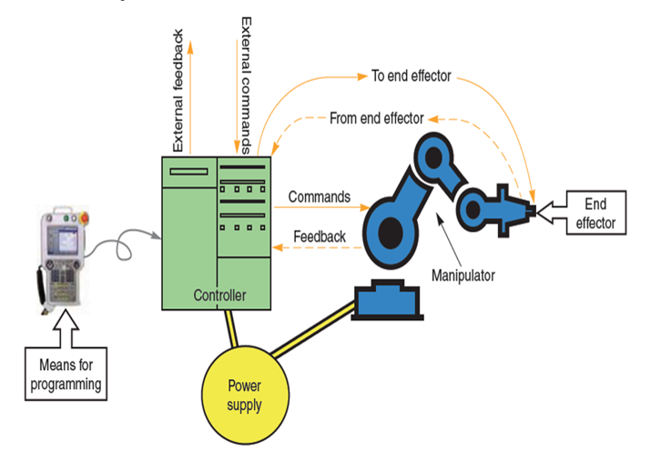
An Example of Industrial Robot
https://www.studocu.com/row/document/university-of-mines-and-technology/introduction-to-robotics/introduction-to-robotics-lecture-notes-1/15921441

Slide 25
THE END

